Slide 1
Process and Project Metrics

Slide 2
Software metrics
Software metrics (process and project) are quantitative measures
Measurement can be applied
To the software process with the intent of improvement
To assist in estimation, quality control, productivity assessment, and project control
To help assess the quality of technical work products
To assist in tactical decision making as a project proceeds

Slide 3
Metric and Indicator
A metric is a quantitative measure of the degree to which a system, component, or process possesses a given attribute.
An indicator is a metric or combination of metrics that provide insight into the software process, a software project, or the product itself.
A software engineer collects measures and develops metrics so that indicators will be obtained .

Slide 4
Process Metrics
Process metrics are collected across all projects and over long periods of time.
Process metrics provide a set of process indicators that lead to long-term software process improvement

Slide 5
Project metrics
Enable a software project manager to
Assess the status of an ongoing project
Track potential risks
Uncover problem areas before they "go critical“
Adjust work flow or tasks

Slide 6
Project metrics
Evaluate the project team's ability to control quality of software engineering work products.
Estimate effort and time duration
Every project should measure input, output and result

Slide 7
Process Metrics and Software Process Improvement
The only rational way to improve any process is
To measure specific attributes of the process
Develop a set of meaningful metrics based on these attributes
Use the metrics to provide indicators that will lead to a strategy for improvement

Slide 8
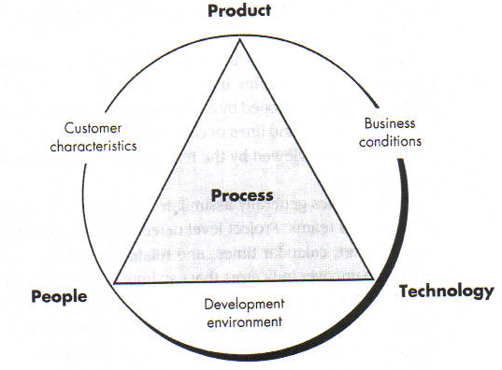
Determinants for Software quality & Organizational Effectiveness
.

Slide 9
Private and Public metric
There are "private and public" uses for different types of process data
Data private to the individual
Serve as an indicator for the individual only
Eg : Defect rates, Errors found during development
Public metric
Defects reported for major software functions
Errors found during formal technical reviews
Lines of code or function points per module/function

Slide 10
Software Measurement
Direct measures
Software process (cost)
Software product (lines of code (LOC), execution speed, defects reported over some set period of time)
Indirect measures
Software product (Functionality, quality, complexity, efficiency, reliability, maintainability )
Many factors affect software work, it is difficult (don’t use metrics) to compare individuals/team

Slide 11
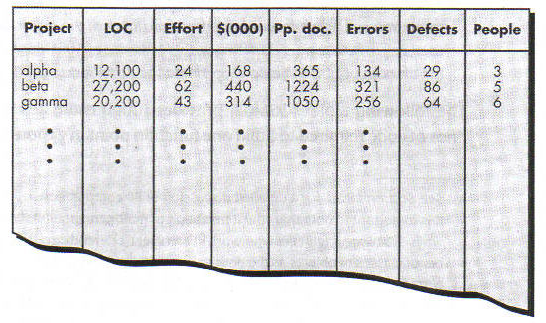
Size-Oriented Metrics
Derived by normalizing quality and/or productivity measures by considering the "size" of the software
Metrics include
Errors per KLOC, Defects per KLOC, Dollars per KLOC, Pages of documentation per KLOC

Slide 12
Function-Oriented Metrics
It is a measure of the functionality delivered by the application as a normalization value
Eg. Number of input, number of output, number of files, number of interfaces

Slide 13
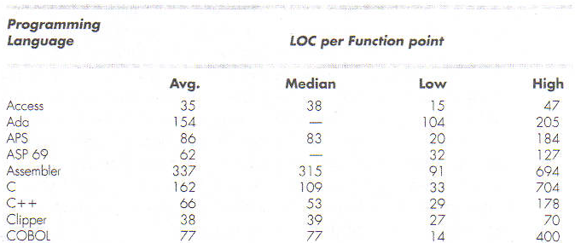
Reconciling LOC & FC Metrics
The relationship between lines of code and function points depends programming language
Rough estimates of the average number of lines of code required to build one function point in various programming languages

Slide 14
Metrics in the Process Domain

Slide 15
Metrics in the Process Domain
Process metrics are collected across all projects and over long periods of time
They are used for making strategic decisions
The intent is to provide a set of process indicators that lead to long-term software process improvement
The only way to know how/where to improve any process is to
Measure specific attributes of the process
Develop a set of meaningful metrics based on these attributes
Use the metrics to provide indicators that will lead to a strategy for improvement

Slide 16
Metrics in the Process Domain (continued)
We measure the effectiveness of a process by deriving a set of metrics based on outcomes of the process such as
Errors uncovered before release of the software
Defects delivered to and reported by the end users
Work products delivered
Human effort expended
Calendar time expended
Conformance to the schedule
Time and effort to complete each generic activity

Slide 17
Etiquette of Process Metrics
Use common sense and organizational sensitivity when interpreting metrics data
Provide regular feedback to the individuals and teams who collect measures and metrics
Don’t use metrics to evaluate individuals
Work with practitioners and teams to set clear goals and metrics that will be used to achieve them
Never use metrics to threaten individuals or teams
Metrics data that indicate a problem should not be considered “negative”
Such data are merely an indicator for process improvement
Don’t obsess on a single metric to the exclusion of other important metrics

Slide 18
Metrics in the Project Domain

Slide 19
Metrics in the Project Domain
Project metrics enable a software project manager to
Assess the status of an ongoing project
Track potential risks
Uncover problem areas before their status becomes critical
Adjust work flow or tasks
Evaluate the project team’s ability to control quality of software work products
Many of the same metrics are used in both the process and project domain
Project metrics are used for making tactical decisions
They are used to adapt project workflow and technical activities

Slide 20
Use of Project Metrics
The first application of project metrics occurs during estimation
Metrics from past projects are used as a basis for estimating time and effort
As a project proceeds, the amount of time and effort expended are compared to original estimates
As technical work commences, other project metrics become important
Production rates are measured (represented in terms of models created, review hours, function points, and delivered source lines of code)
Error uncovered during each generic framework activity (i.e, communication, planning, modeling, construction, deployment) are measured

Slide 21
Use of Project Metrics (continued)
Project metrics are used to
Minimize the development schedule by making the adjustments necessary to avoid delays and mitigate potential problems and risks
Assess product quality on an ongoing basis and, when necessary, to modify the technical approach to improve quality
In summary
As quality improves, defects are minimized
As defects go down, the amount of rework required during the project is also reduced
As rework goes down, the overall project cost is reduced

Slide 22
Software Project Planning
The overall goal of project planning is to establish a pragmatic strategy for controlling, tracking, and monitoring a complex technical project.
Why?
So the end result gets done on time, with quality!

Slide 23
Estimation
Estimation of resources, cost, and schedule for a software engineering effort requires
experience
access to good historical information (metrics)
the courage to commit to quantitative predictions when qualitative information is all that exists
Estimation carries inherent risk and this risk leads to uncertainty

Slide 24
Estimation Techniques
Past (similar) project experience
Conventional estimation techniques
task breakdown and effort estimates
size (e.g., FP) estimates
Empirical models
Automated tools

Slide 25
Conventional Two types of Metrics
Size oriented
Function Point oriented

Slide 26
Size-oriented Metrics
Derived by normalizing quality and/or productivity measures by considering the size of the software produced
Thousand lines of code (KLOC) are often chosen as the normalization value
Metrics include
Errors per KLOC - Errors per person-month
Defects per KLOC - KLOC per person-month
Dollars per KLOC - Dollars per page of documentation
Pages of documentation per KLOC

Slide 27
Size-oriented Metrics (continued)
Size-oriented metrics are not universally accepted as the best way to measure the software process
Opponents argue that KLOC measurements
Are dependent on the programming language
Penalize well-designed but short programs
Cannot easily accommodate nonprocedural languages
Require a level of detail that may be difficult to achieve

Slide 28
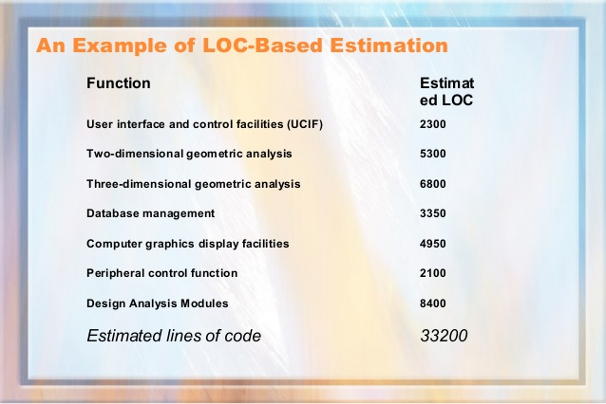
Example: LOC Approach
Average productivity for systems of this type = 620 LOC/pm.
Burdened labor rate =$8000 per month, the cost per line of code is approximately $13.
Based on the LOC estimate and the historical productivity data, the total estimated project cost is $431,000 and the estimated effort is 54 person-months.

Slide 29
Function-Oriented Metrics
Function-oriented metrics use a measure of the functionality delivered by the application as a normalization value
Most widely used metric of this type is the function point: FP = count total * [0.65 + 0.01 * sum (value adj. factors)]
Function point values on past projects can be used to compute, for example, the average number of lines of code per function point (e.g., 60)

Slide 30
Function Points (5 characteristics ) Based on a combination of program 5 characteristics
The number of :
External (user) inputs: input transactions that update internal files
External (user) outputs: reports, error messages
User interactions: inquiries
Logical internal files used by the system:
Example a purchase order logical file composed of 2 physical
files/tables Purchase_Order and Purchase_Order_Item
External interfaces: files shared with other systems

Slide 31
Function Points (FP)
A weight is associated with each of the above 5 characteristics
Weight range:
from 3 for simple feature to
15 for complex feature
The function point count is computed by multiplying each raw count by the weight and summing all values

Slide 32
FP Calculation

Slide 33
Adjusted Function Points Count Complexity: 14 Factors Fi
1.Backup and recovery
2.Data communication
3.Distributed processing functions
4.Is performance critical?
5.Existing operating environment
6.On-line data entry
7.Input transaction built over multiple screens

Slide 34
Adjusted Function Points Count Complexity: 14 Factors Fi
8.Master files updated on-line
9.Complexity of inputs, outputs, files, inquiries
10.Complexity of processing
11.Code design for re-use
12.Are conversion/installation included in design?
13.Multiple installations
14.Application designed to facilitate change by the user

Slide 35
Final computation
Value adjustment factor (Fi) = SUM ( Backup and recovery +
Data communication +
Performance Criteria etc..)
FPestimated = Count_total * [ 0.65 + 0.01* ∑ (Fi) ]

Slide 36
Function Points
Each of the F_{i} criteria are given a rating of 0 to 5 as:
No Influence = 0; Incidental = 1;
Moderate = 2 Average = 3;
Significant = 4 Essential = 5

Slide 37
Function-Oriented Metrics
Once function points are calculated, they are used in a manner analogous to LOC as a measure of software productivity, quality and other attributes, e.g.:
productivity FP/person-month
quality faults/FP
cost $$/FP
documentation doc_pages/FP

Slide 38
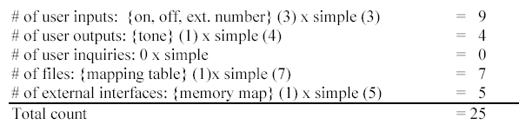
Example: Function Points

Slide 39
Example 1
Consider the average as the degree of complexity with following functional units and compute the function point for the project
Number of input = 40
Number of output = 28
Number of user enquiries = 32
Number of user files = 9
Number of external interface = 5
Adjustment factor = 1.07

Slide 40
Example 2
i] Number of user inputs=5, with degree of complexity equal to simple
ii] Number of user output=10, with degree of complexity equal to average
iii] Number of user enquiries=5, with degree of complexity equal to complex
iv] Number of user files=8, with degree of complexity equal to simple
v] Number of external interfaces=3, with degree of complexity equal to complex
vi] Backup and recovery= 0.5
vi] Adjustment factor excluding Backup and recovery is 1.07, compute the function point for the project.

Slide 41
Empirical Estimation Method COCOMO II

Slide 42
The COCOMO II Model
The Constructive Cost Model (COCOMO) is an algorithmic software cost estimation model
Based on the complexity the project can be divided into 3 different modes
Organic mode (simple)
Semi-detached mode (medium)
Embedded mode (complex)
Effort =a * KLOC ^{b}, (in person/months)
Duration =c * effort ^{d}, (in months)
Staffing =Effort/Duration

Slide 43
The COCOMO II Model
Organic mode (simple)
a = 2.4, b = 1.05, c = 2.5, d = 0.38
Semi-detached mode (medium)
a = 3, b = 1.12, c = 2.5, d = 0.35
Embedded mode (complex)
a = 3.6, b = 1.2, c = 2.5, d = 0.32

Slide 44
Assume that the size of an organic type software product has been estimated to
be 32,000 lines of source code. Assume that the average salary of software engineers be Rs. 15,000/- per month. Determine the effort required to develop the software product and the nominal development time. From the basic COCOMO estimation formula for organic software:

Slide 45
Reconciling LOC and FP Metrics
Relationship between LOC and FP depends upon
The programming language that is used to implement the software
The quality of the design
FP and LOC have been found to be relatively accurate predictors of software development effort and cost
However, a historical baseline of information must first be established
LOC and FP can be used to estimate object-oriented software projects
However, they do not provide enough granularity for the schedule and effort adjustments required in the iterations of an evolutionary or incremental process
The table on the next slide provides a rough estimate of the average LOC to one FP in various programming languages

Slide 46
LOC Per Function Point
Language | Average | Median | Low | High
Ada | 154 | -- | 104 | 205
Assembler | 337 | 315 | 91 | 694
C | 162 | 109 | 33 | 704
C++ | 66 | 53 | 29 | 178
COBOL | 77 | 77 | 14 | 400
Java | 55 | 53 | 9 | 214
PL/1 | 78 | 67 | 22 | 263
Visual Basic | 47 | 42 | 16 | 158
www.qsm.com/?q=resources/function-point-languages-table/index.html

Slide 47
Metrics for Software Quality
Correctness
This is the number of defects per KLOC, where a defect is a verified lack of conformance to requirements
Defects are those problems reported by a program user after the program is released for general use
Maintainability
This describes the ease with which a program can be corrected if an error is found, adapted if the environment changes, or enhanced if the customer has changed requirements
Mean time to change (MTTC) : the time to analyze, design, implement, test, and distribute a change to all users
Maintainable programs on average have a lower MTTC

Slide 48
Defect Removal Efficiency
Defect removal efficiency provides benefits at both the project and process level
It is a measure of the filtering ability of QA activities as they are applied throughout all process framework activities
It indicates the percentage of software errors found before software release
It is defined as DRE = E / (E + D)
E is the number of errors found before delivery of the software to the end user
D is the number of defects found after delivery
As D increases, DRE decreases (i.e., becomes a smaller and smaller fraction)
The ideal value of DRE is 1, which means no defects are found after delivery
DRE encourages a software team to institute techniques for finding as many errors as possible before delivery

